Slide 1
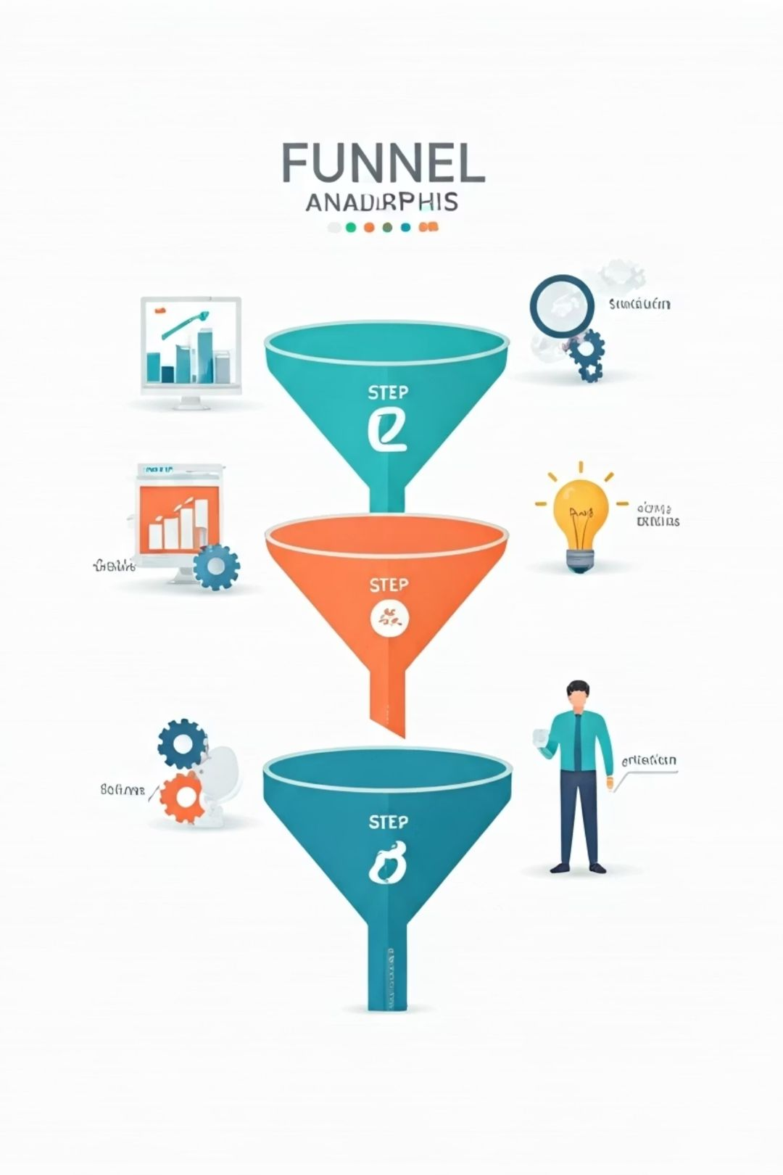
From Data to Decisions: A Product Analytics Journey
Leveraging Power BI, DAX & Consulting Principles for Real Business Insight
Date: June 2025
Tools: Power BI, DAX, PwC Consulting(via Forage), Product Metrics
Done By: Haritha S

Slide 2

The Challenge: Beyond Basic Dashboards
My previous dashboards lacked depth in product insights and a clear business narrative. I struggled to apply advanced product metrics and connect visuals to real business outcomes.
1
2
3
4
Situation
Task
Action
Result
While I could build functional dashboards using Power BI and SQL Server, they lacked product insight , DAX depth, and a clear business narrative.
I set a goal to upskill both technically ,
strategically — to apply real product metrics
and tie dashboards to business goals.
I completed the PwC Tech Consulting Virtual Internship .
self-learned metrics like
funnel, retention, churn, and
ROI, implementing them
through DAX in Power BI.
This project blends analytics with consulting structure, delivering actionable insights
through a product-focused, decision-ready dashboard.

Slide 3




The Solution: Upskilling & Consulting Mindset
Consulting Lens
Learned user stories, acceptance criteria, and business-aligned roadmaps through PwC.
Product Metrics
Self-learned funnel analysis, retention, churn, activation,
and ROI with DAX.
Technical Proficiency
Combined new knowledge to build an actionable Power BI dashboard.

Slide 4

User Story: Bridging the Gap
As a data analyst transitioning from basic dashboards to business-impact-driven insights, I want to apply real product metrics like funnel analysis, retention, and ROI using Power BI, so that I can understand user behavior deeply, enhance decision-making, and showcase a project aligned with consulting principles.

Slide 5





Acceptance Criteria: Ensuring Meaningful Insights
Key Business Questions
Visuals & Filters
1
2
Dashboard answers 10 core product metrics
(engagement, activation, retention, churn, revenue, ROI).
Each page includes visuals, DAX measures, and
user-friendly filters (age, country, Product category, year).
Accurate DAX
Insight Boxes
Calculations like average revenue per user and
churn rate are accurate and logically structured.
4
3
Every metric section presents clear, data-driven
Insights, summarizing data revelations.

Slide 6
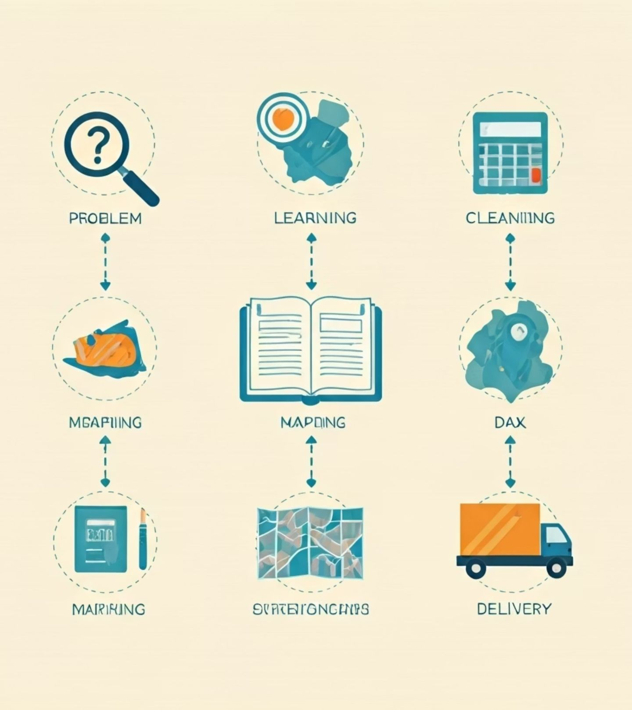
Structured Roadmap: From Problem to Portfolio

Slide 7
Problem & Skill Gap
Identified missing business metrics and data storytelling in previous work.
Learning & Upskilling
PwC internship for consulting frameworks; deep
dive into product metrics.
Data & Metrics Mapping
Cleaned dataset, mapped product metrics to data
questions, planned layouts.
DAX & Visualization
Developed DAX measures, designed interactive visuals for
storytelling.
Insights & Summary
Derived actionable insights, created Executive Summary.
Packaging & Documentation
Structured project into a professional PDF report for portfolio.

Slide 8
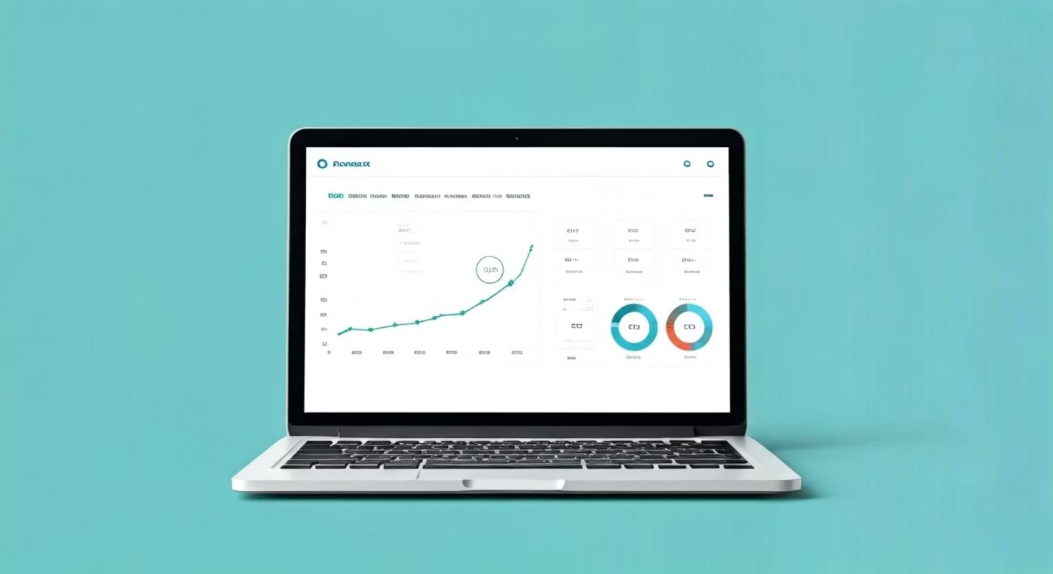
PRODUCT METRICS IN FOCUS
1
Funnel analysis
2
Retention analysis
3
Churn rate
4
Engagement metrics
5
Activation rate
6
Time to Convert
7
Referral and Loyalty
8
Revenue Metrics
9
Return On Investment

Slide 9

"Before the metrics speak!!, let’s meet the language they speak!!!"

Slide 10
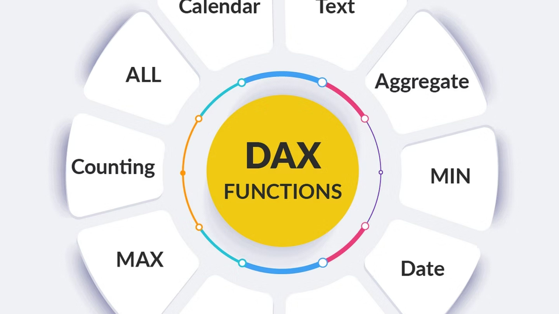
Under the Hood: Where the Magic Happens (DAX Style)!!

Slide 11
Section 1: Key Measures
DAX Measure Name
Purpose
Avg Revenue per Customer
Revenue performance per user
Avg_Age_Repeat
Average age of repeat customers
Customer_Purchase_Count
Total purchases made by each user
Date First Purchase
First transaction date per user
DateRange
Reported time period
First Purchase Count
Count of users making their first purchase
Is_Repeat_Customer
Classify customers as repeat or one-time
Repeat Customer Count
Distinct count of returning customers
Retention Rate
% of users that returned
Total_Countries
Distinct countries
Total_Customers
Unique customers
Total_Sales
Total purchase revenue
Total_Transactions
Total number of transactions
UniqueUser
Distinct count of customers

Slide 12
Section 2: Calculated Columns
Column Name
Purpose
First_Purchase
First transaction date for each user
Is_First_Purchase
Flag to identify a user's first purchase
DayOfWeek
Extract weekday from transaction date
Age (Bins)
Grouped customer ages for segmentation

Slide 13

"The formulas above were secret spells.Now, let’s reveal the story they unlocked."
But before the visuals steal the show —Here’s what I discovered, one insight at a time...

Slide 14
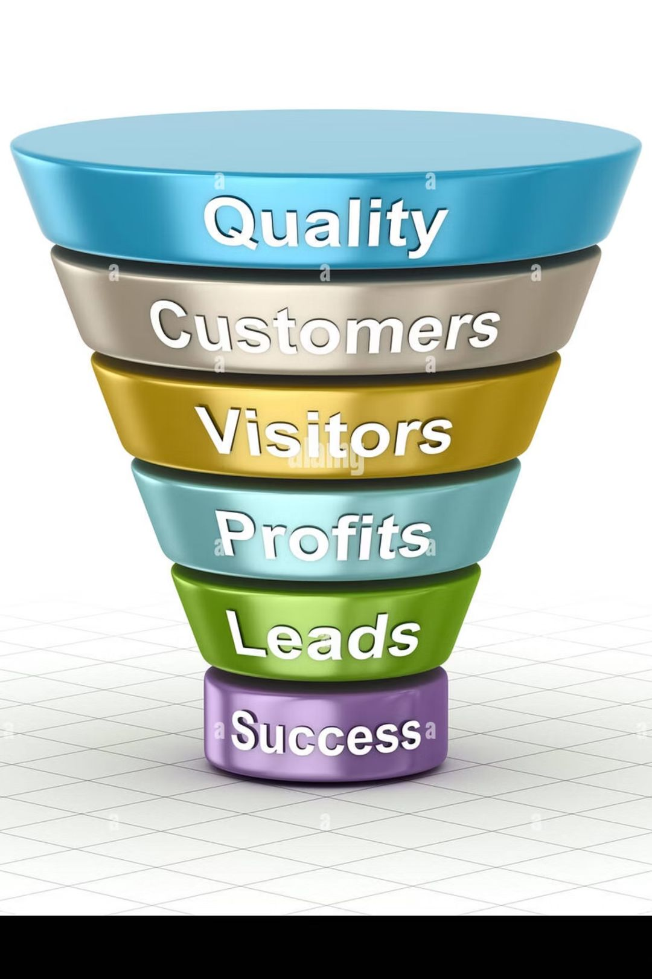
🔍 What I Found – Metric by Metric:
Engagement — Who clicks the most and when?
Activation — What wins the customer's first move?
Loyalty — Who keeps coming back for more?
Retention — Who’s still with us after the first date?
Revenue — Where’s the money coming from, and how much?
Referral — What do people from different regions buy?
Funnel — Who’s making it through, who’s dropping off?
Time to Convert — Who commits fast, and who plays hard to get?
ROI — What’s each customer really worth?

Slide 15

"Let’s dive into the dashboards — captured live from Power BI and brought to life, one metric at a time."

Slide 16

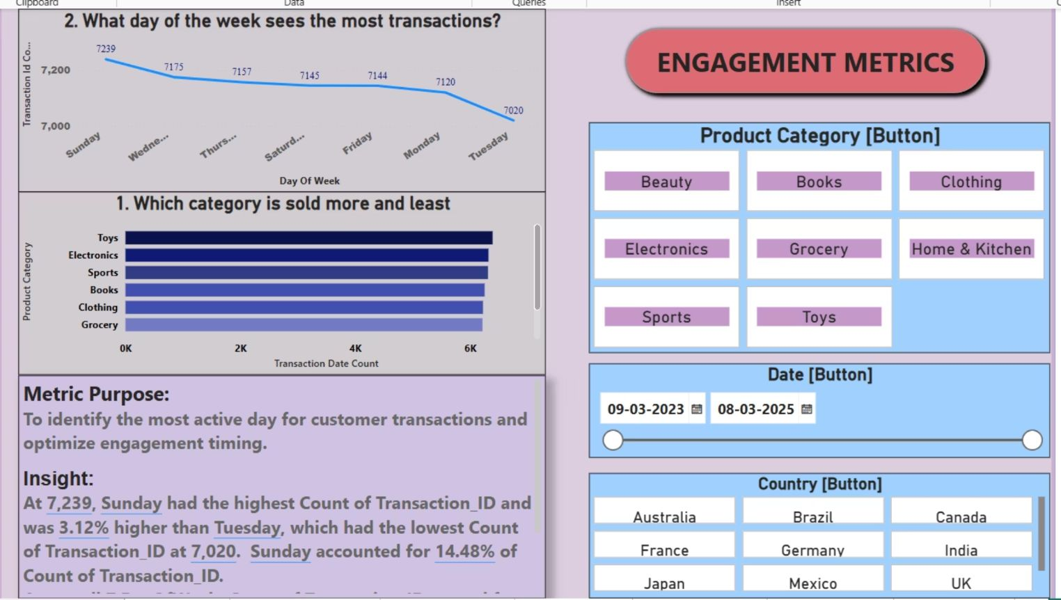
Engagement Deep Dive: Discovering what captivates our users and tracking daily activity trends.

Slide 17
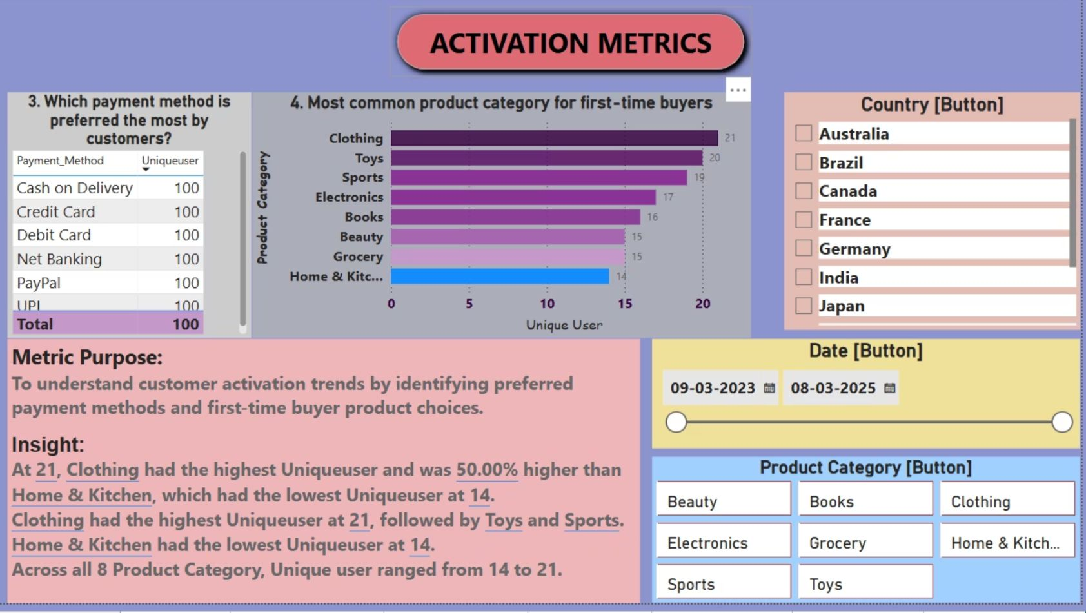
"First impressions matter — see how they pay and what they grab first!"

Slide 18
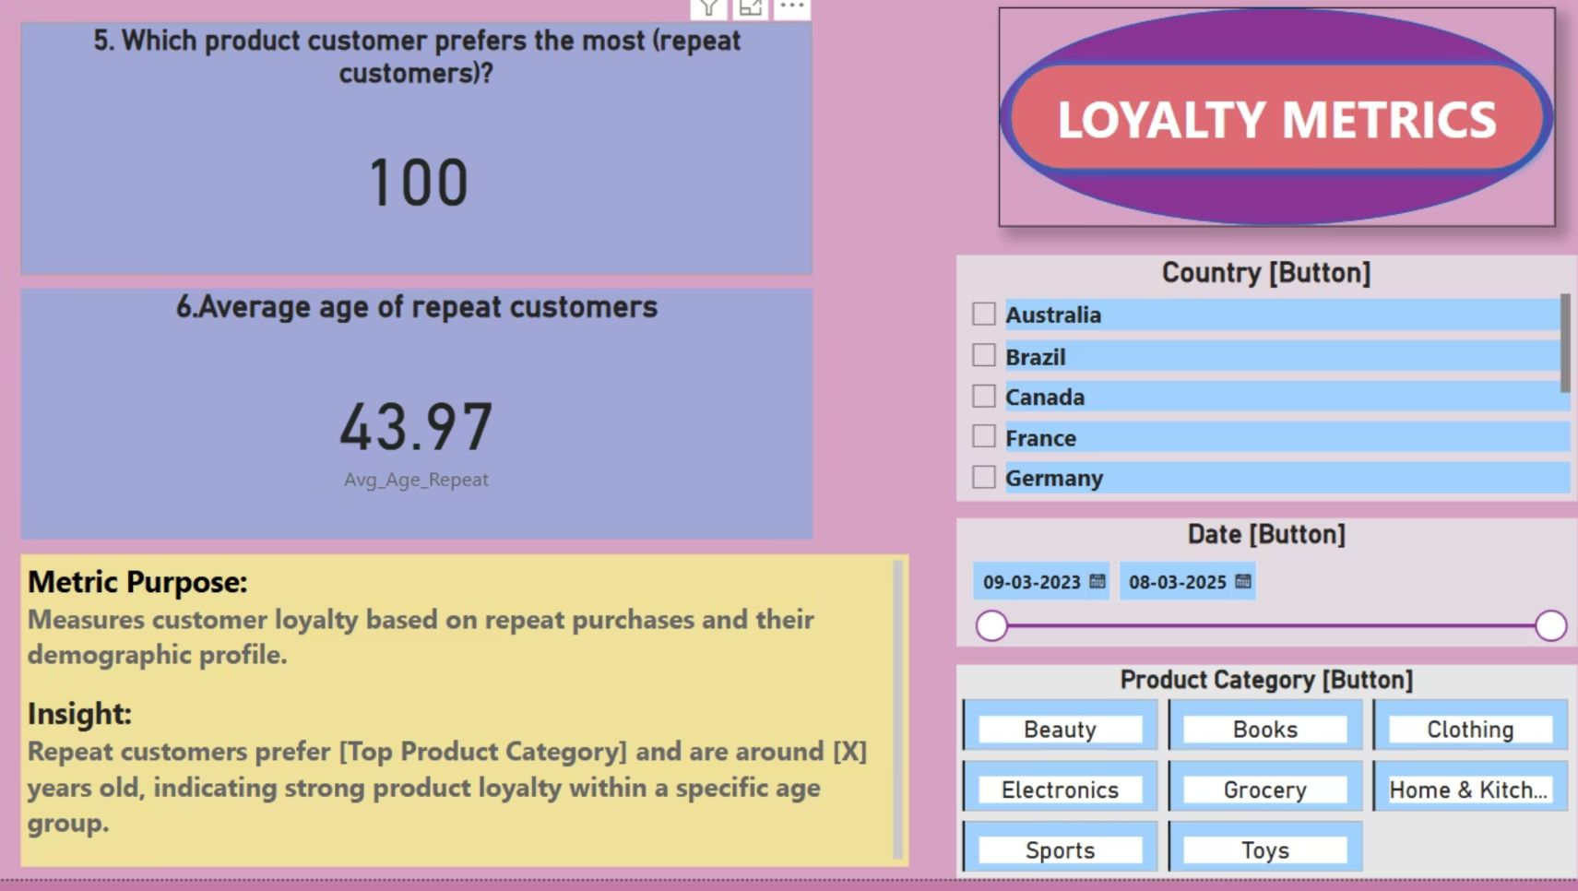
"Loyal love — who keeps coming back, and how old is our fan club?"

Slide 19
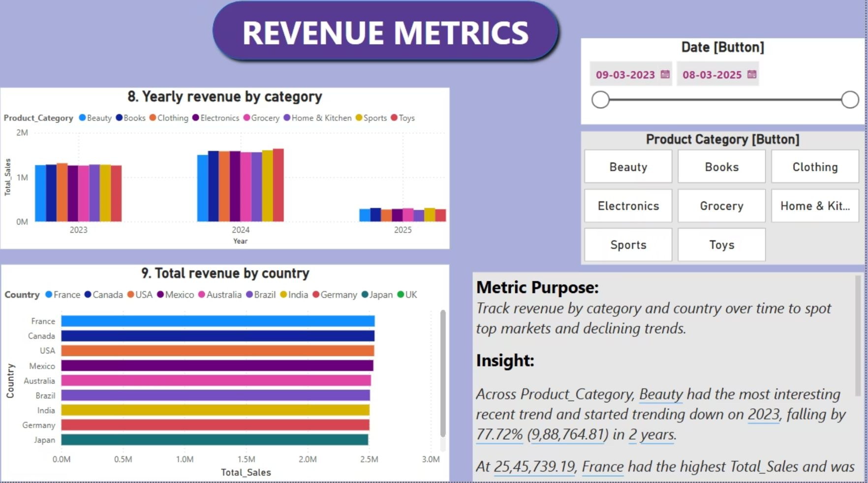
"Follow the money — who's buying what, and where the money rains!"

Slide 20
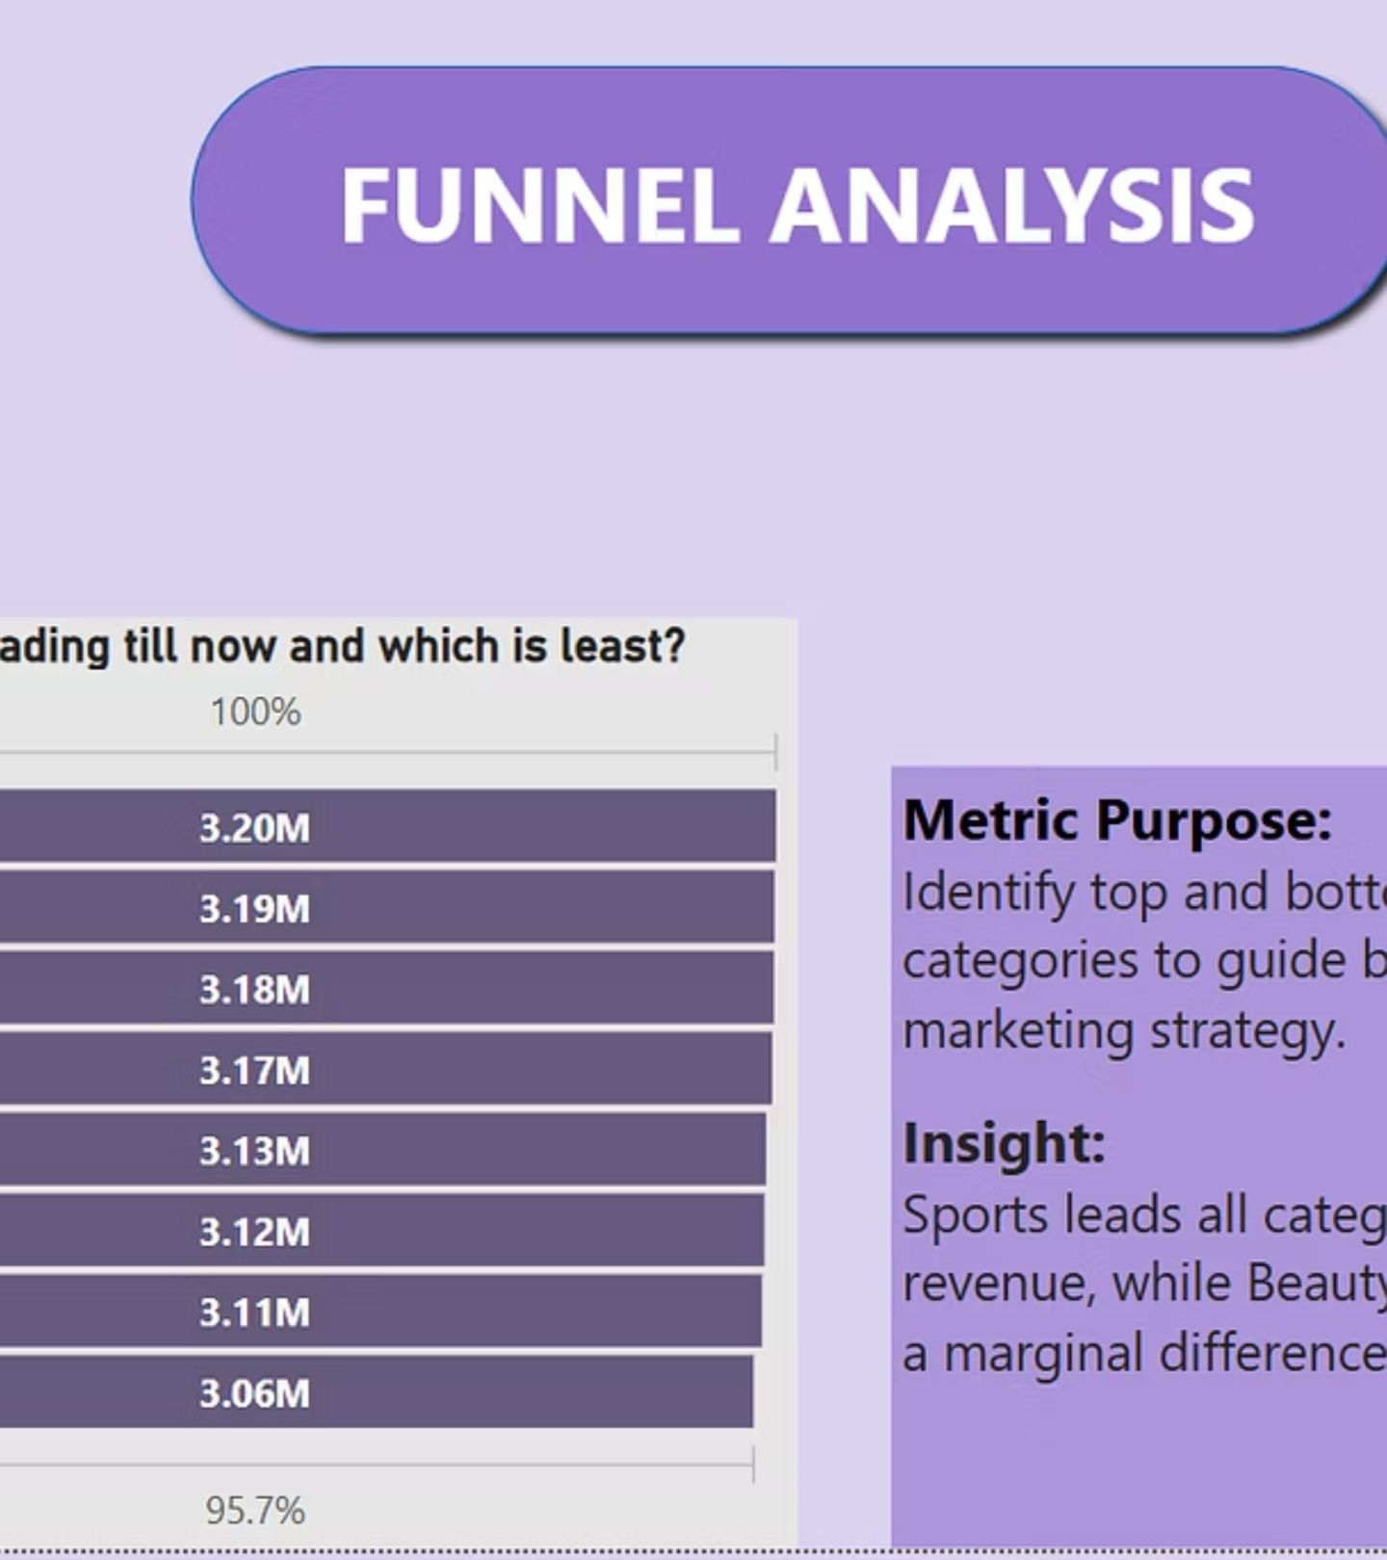
"From click to cart — who makes it to the finish line, and who gets abandoned?"

Slide 21
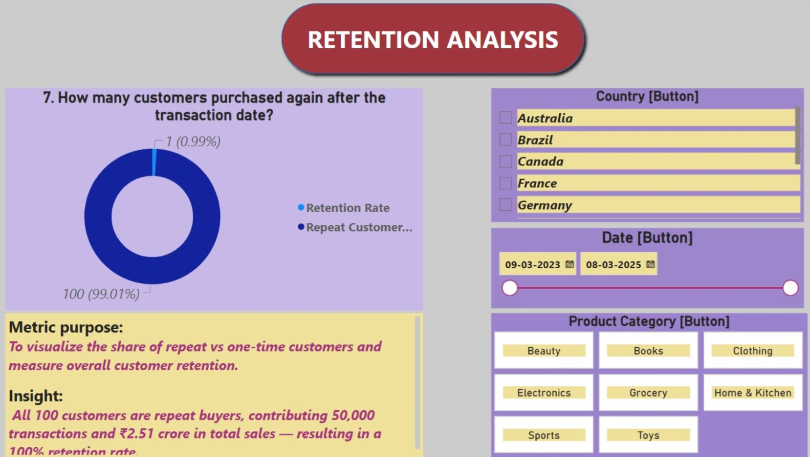
"Follow the money — who's buying what, and where the money rains!"

Slide 22
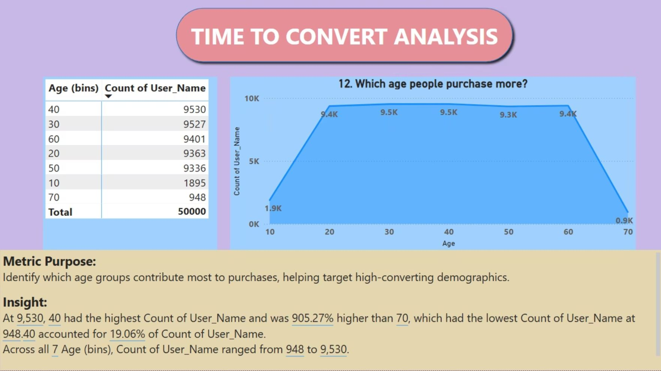
"Fast shoppers vs. slow thinkers — how long do they take to commit?"

Slide 23
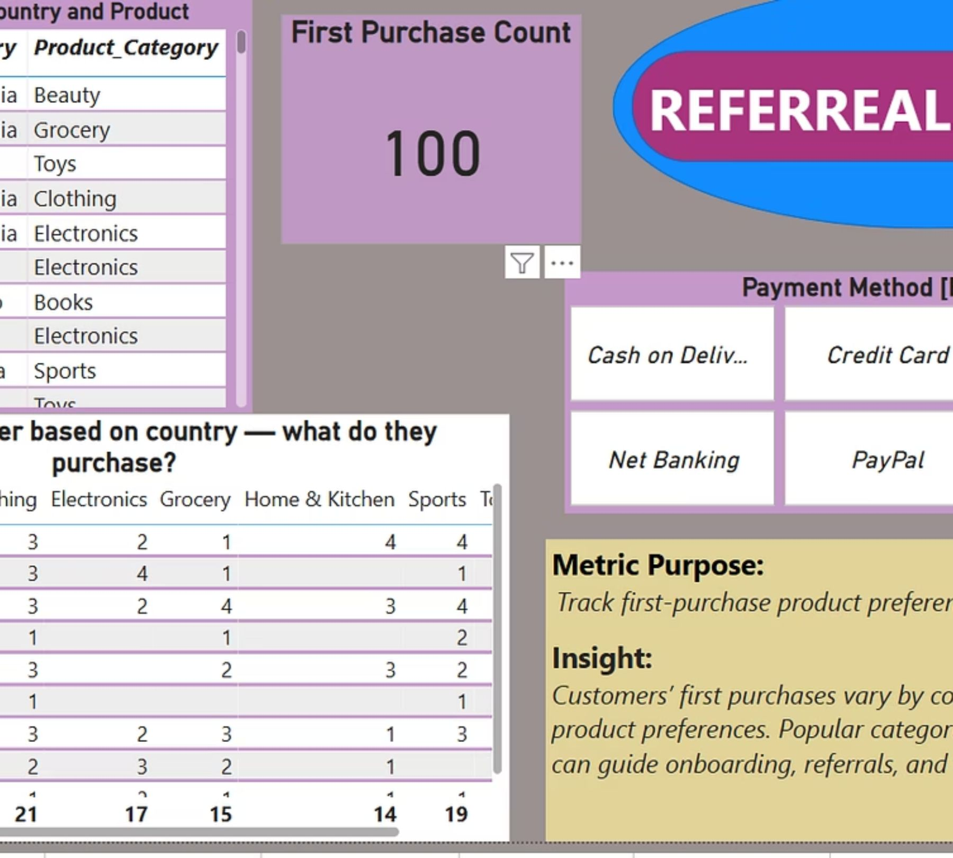
"Your first buy says a lot about you — and your country apparently!"

Slide 24
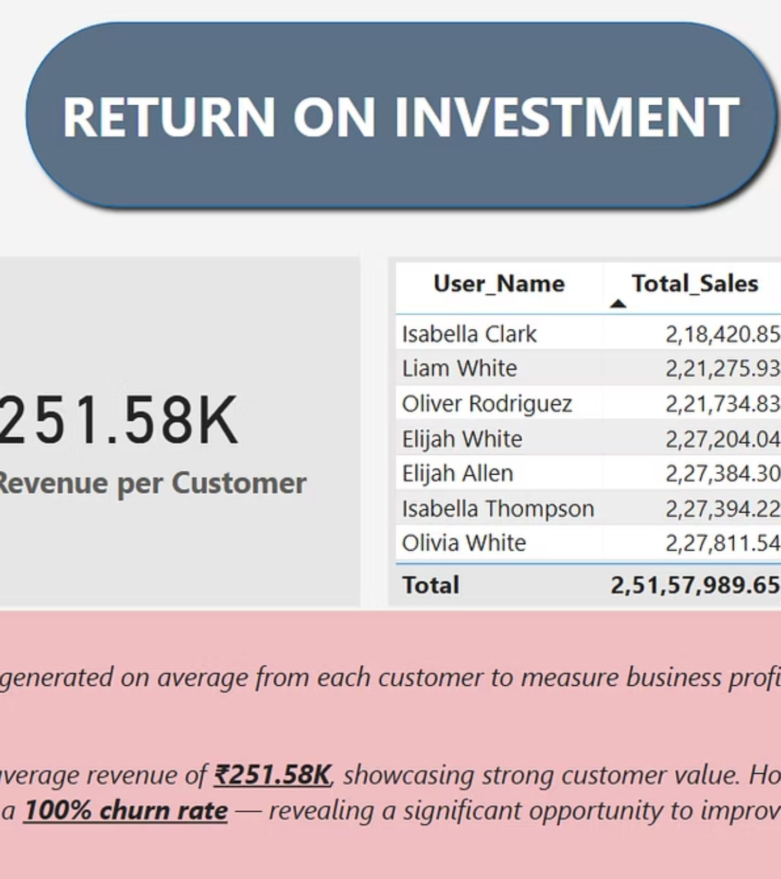
"How much is each customer worth? Let’s do the math and flex the ROI!"

Slide 25
Behind the Metrics: What I Learned from the Data
What started as rows of transactional data transformed into a journey of curiosity — one insight at a time. I explored what customers buy, when they engage, and what makes them return. I discovered that engagement spikes on certain days and around specific product categories. I learned how first-time buyers behave differently, how loyalty shows up in preferences, and how revenue flows across regions. From funnel patterns to referral behaviors, from time-to-convert gaps to ROI snapshots — every metric became a clue in understanding the bigger picture. Together, they didn’t just answer business questions — they revealed how data, when explored with intention, becomes a powerful guide for product strategy and smarter decisions.

Slide 26

What I Learned from This Project
Through this project, I didn’t just sharpen my skills in Power BI or DAX — I discovered how much I love asking the “why” behind the data.I learned that I enjoy turning raw numbers into stories, and stories into strategies. I became more confident not just in using tools, but in thinking like a decision-maker.
Most of all, I realized that I’m not just building dashboards — I’m building clarity. And I’m excited to keep learning, exploring, and growing through every new dataset I meet.

Slide 27

Conclusion: Actionable Insights for Decision-Making
This project combines technical proficiency with consulting structure, delivering a dashboard that not only showcases product metrics but also provides actionable business insights. It demonstrates how data, metrics, and business thinking form a compelling decision-making tool.
This project wasn’t just about learning Power BI — it was about learning how to think with data.

